Slide 1
Patient Monitoring System
Team Leader: Robert Tosic
Client: Christopher Burger
Requirements Engineer: Ryan Randive
Developers: Andy Llactahuamani, Paul Martins
Tester: Zain Quraishi

Slide 2
Requirements Elicitation
As the Client, what did you require this program to do?
As the Requirements Engineer, how did you organize/categorize those requirements into the Requirements Document?

Slide 3
Software Architecture
As the Developers, how did you envision the architectural solution?
How do the requirements relate to your implementation?

Slide 4
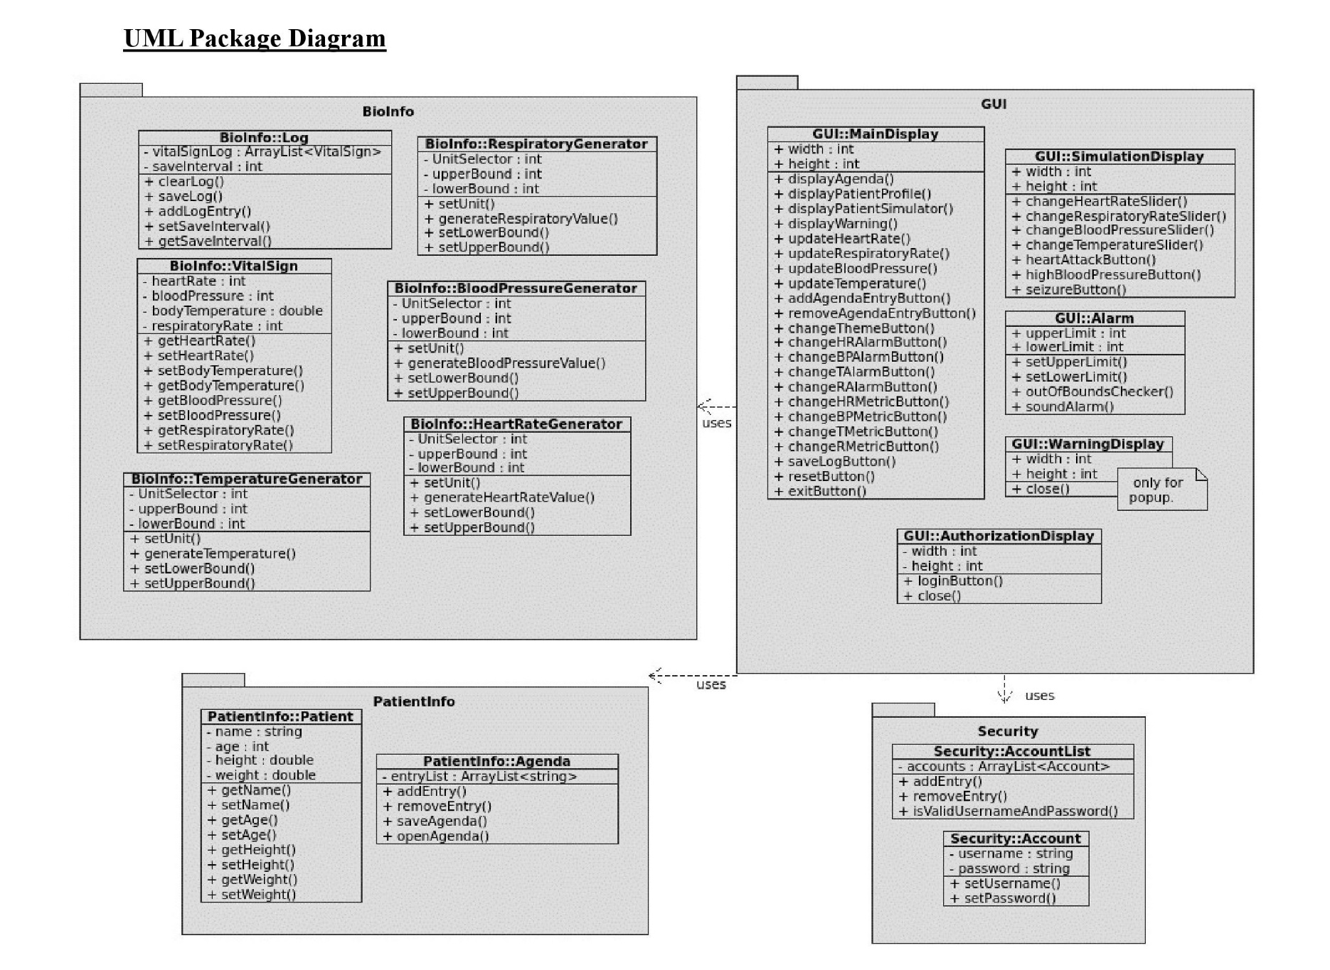

Slide 5
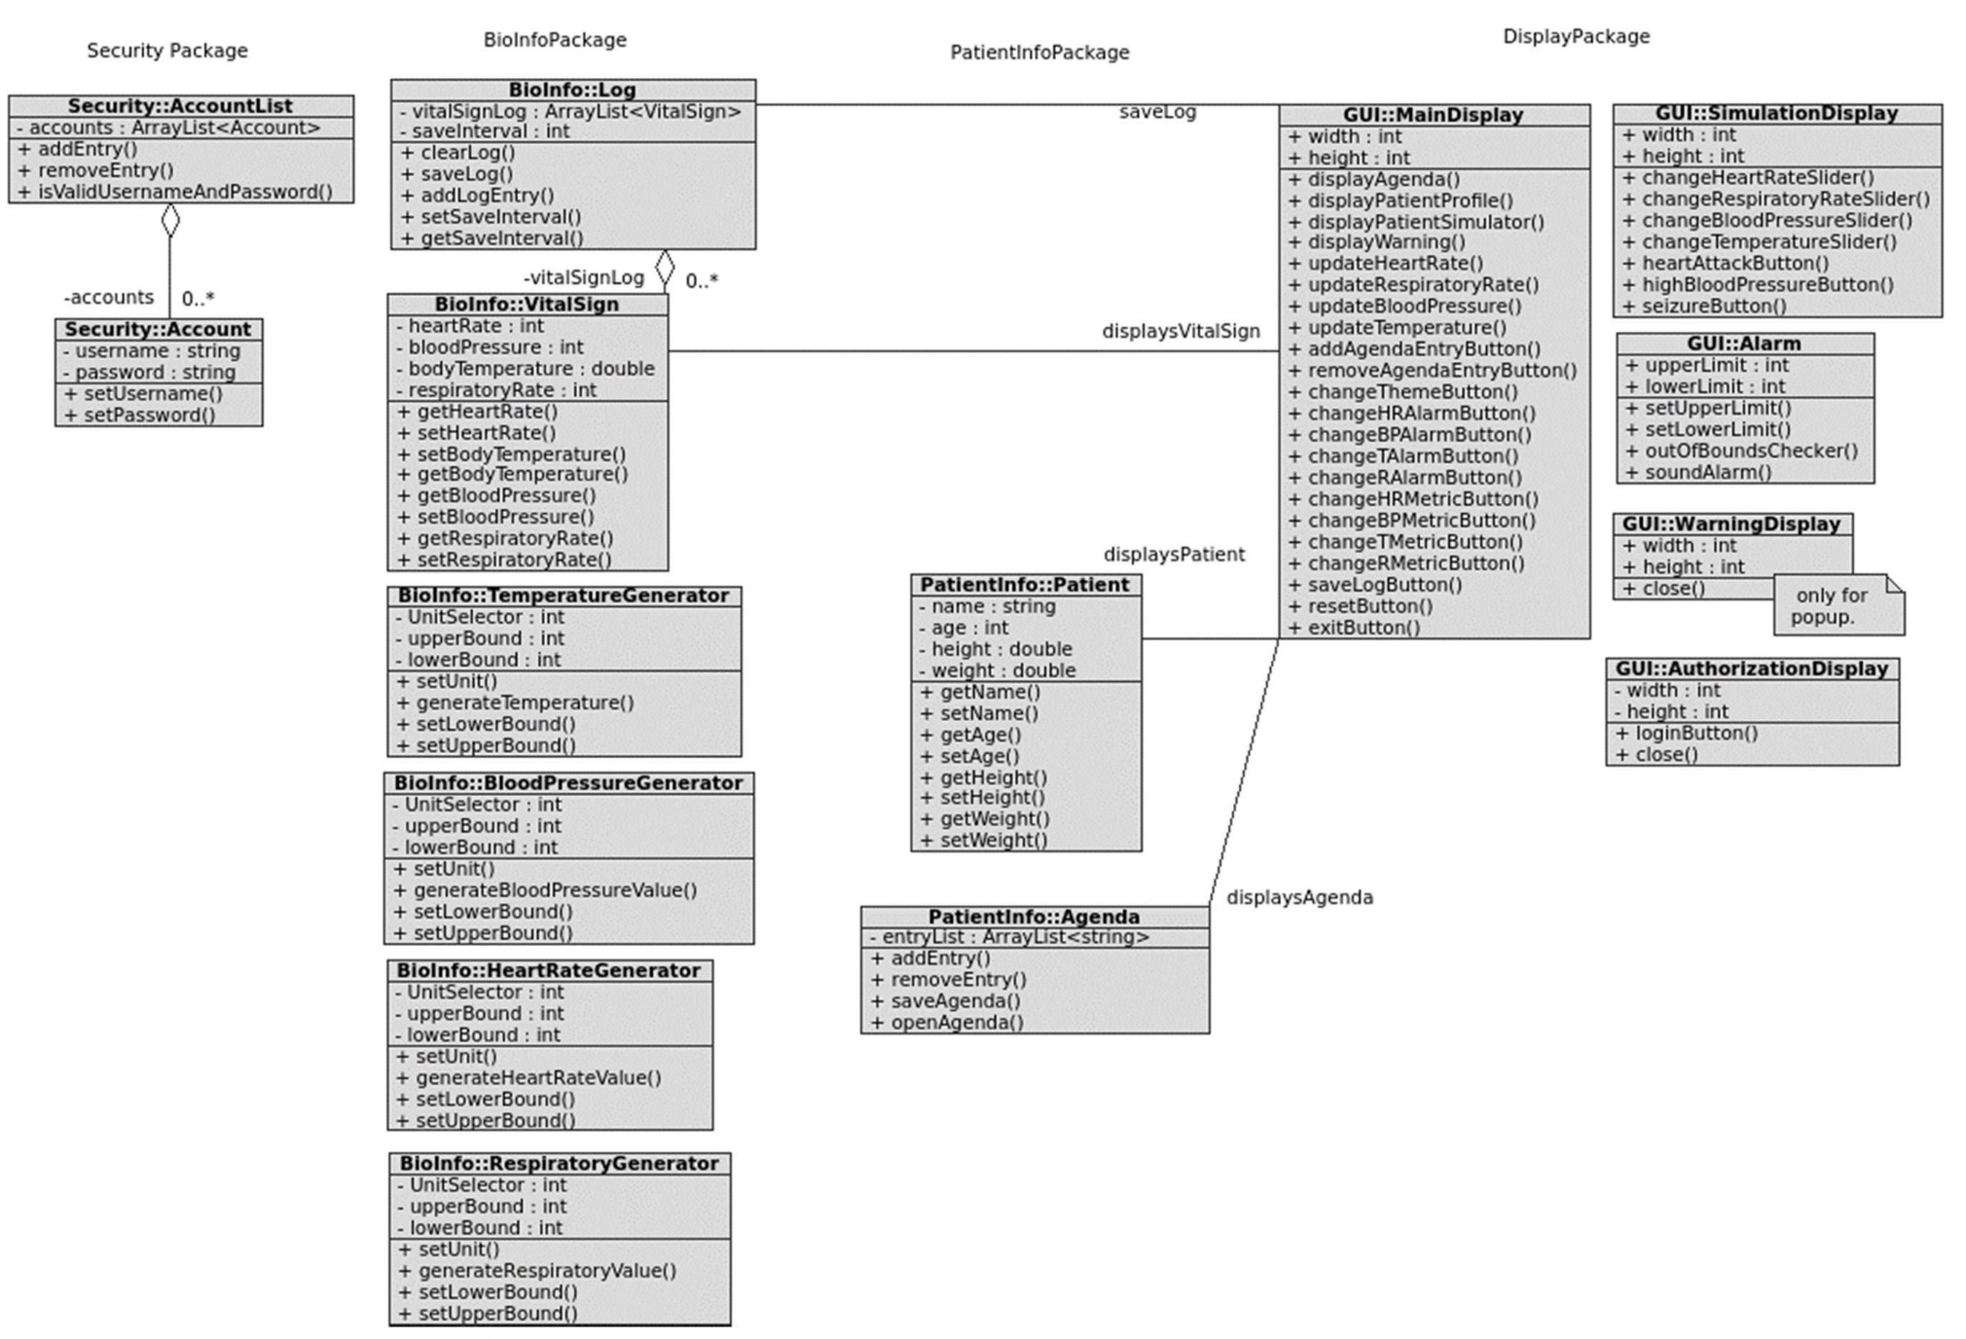

Slide 6
DEMO
Patient Monitoring System

Slide 7
Testing
Verification and Validation
Static Testing, Dynamic Testing
Test Cases

